Slide 1
MCB 5472 Lecture 3 Feb 10/14
Types of homology
BLAST

Slide 2
Homology references
“Homology a personal view on some of the problems”
Fitch WM (2000) Trends Genet. 16: 227-231
“Orthologs, paralogs, and evolutionary genomics”
Koonin EV (2005) Annu. Rev. Genet. 39: 309-338

Slide 3
What is homology?
Owen 1843: “the same organ in different animals under every variety of form and function”
Huxley (post Darwin): homology evidence of evolution
Similarity is due to descent from a common ancestor

Slide 4
What is homology?
Homology is a statement about shared ancestry
Two things either share a common ancestor (are homologous) or do not

Slide 5
Common ancestor of species 1, 2, 3
Common ancestor of species 2, 3
a
b
c
Species 1
Species 2
Species 3
These are all homologs (common ancestor)

Slide 6
Ohno 1970: “Evolution by Gene Duplication”
New genes arise by gene duplication
One copy retains ancestral function
Other copy diverges functionally
“Homolog” as a single term therefore is a sloppy fit
What kind of ancestor to homologs share?

Slide 7
Fitch 1970: “Orthologs” and “Paralogs”
“Orthologs”: genes related by vertical descent

Slide 8
Common ancestor of species 1, 2, 3
Common ancestor of species 2, 3
a
b
c
Species 1
Species 2
Species 3
These are all homologs (common ancestor)
These are all orthologs (vertical descent)

Slide 9
Homology and Function
Homology and function are two different concepts
Strict orthology and functional conservation often correlate but this is not absolute
Basis for annotating genomes based on similarity to previous work

Slide 10
Fitch 1970: “Orthologs” and “Paralogs”
“Orthologs”: genes related by vertical descent
“Paralogs”: gene related by gene duplication

Slide 11
Common ancestor of species 1, 2, 3
Common ancestor of species 2, 3
Duplication in
species 1
a
b
c
d
Species 1
Species 2
Species 3
Genes a, b, c & d are homologs (common ancestor)
Genes a & b are paralogs (related by duplication)

Slide 12
Orthology/paralogy is somewhat relative
Depends on the depth of duplication relative to common ancestry
“Co-orthologs”: paralogs formed in a lineage after speciation, relative to other lineages (Koonin 2005)

Slide 13
Common ancestor of species 1, 2, 3
Common ancestor of species 2, 3
Duplication in
species 1
a
b
c
d
Species 1
Species 2
Species 3
Genes a & b are paralogs (related by duplication)
Genes a & b are co-orthologs of genes c & d
(duplication followed speciation)

Slide 14
Common ancestor of species 1, 2, 3
Duplication in ancestor of
species 2 & 3
Duplication in
species 1
Common ancestor of
species 2, 3
a
d
a
b
c
e
f
Genes a & b are paralogs (duplication)
Genes a & b are co-orthologs of c, d, e & f
(duplication followed speciation)

Slide 15
Common ancestor of species 1, 2, 3
Duplication in ancestor of
species 2 & 3
Duplication in
species 1
Common ancestor of
species 2, 3
a
d
a
b
c
e
f
Genes c & d are orthologs (common ancestor)
Genes e & f are orthologs (common ancestor)
Genes c & d are paralogs of genes e & f
(duplication preceded speciation)

Slide 16
Common ancestor of species 1, 2, 3
Duplication in ancestor of
species 2 & 3
Duplication in
species 1
Common ancestor of
species 2, 3
(Loss of d)
(Loss of e)
a
a
b
c
f
Genes c is a paralog of gene f even though it doesn’t seem so
(duplication still preceded speciation followed by extinction)

Slide 17
Xenologs
Bacteria exchange DNA between distant relatives by horizontal gene transfer (HGT)
Increasingly recognized in eukaroytes too
Gene tree does not match species tree

Slide 18
Common ancestor of species 1, 2, 3
Common ancestor of species 2, 3
HGT from species 2 ancestor to species 1
a
b
c
d
Species 1
Species 2
Species 1
Species 3
Gene c is a xenolog relative to the others

Slide 19
Other “-logs”
Inparalogs: duplication follows speciation
Outparalogs: duplication precedes speciation
Synlogs: arising from organism fusion

Slide 20
Orthology & paralogy can get quite complicated when multiple duplications happened at different moments in time
Gene loss & HGT can always confound – one often has to rely on external evidence to recreate speciation
E.g., other genes not thought to be horizontally transferred, average signal of multiple genes

Slide 21
Discuss: how are these genes related to each other? Three possibilities
Species 1
Species 2
Species 3

Slide 22
How to determine orthologs
Most detailed: phylogenetic trees
Can be computationally expensive
Reciprocal BLAST hit (RBH/BBH)
Simplest, computationally cheap, less accurate & more complicated with many genomes
More complicated RBH clustering
OrthoMCL, Inparanoid

Slide 23
RBH orthologs
Genome A
Genome B
Best matches in both directions - ortholog
Best matches in both directions - ortholog
Best matches in only 1 direction - not ortholog
Genome A
Genome B
Different matches in each direction - not ortholog
Different matches in each direction - not ortholog

Slide 24
BLAST
Standard method to identify homologous sequences
Not for comparing two sequences directly; use NEEDLE instead for this (global vs. local alignment methods)
Requires database to query sequence against
Probably the most common scientific experiment

Slide 25
Different BLAST types
BLASTn: nucleotide vs nucleotide
BLASTp: protein vs protein
BLASTx: protein vs translated nucleotide
tBLASTn: translated nucleotide vs protein
tBLASTx: translated nucleotide vs translated nucleotide
Nucleotides translated in all six open reading frames

Slide 26
Implimentations
blastall: older command line version
Atschul et al. 1990 J. Mol. Biol. 215:403-410
BLAST+: newer command line version
Camacho et al. 2008 BMC Bioinformatics 10:421
Faster than blastall
Web BLAST:
www.blast.ncbi.nlm.nih.gov/Blast.cgi
Web version of BLAST+

Slide 27
Databases
All BLAST queries are done vs. a database
Examples:
NCBI’s “nr” queries against all of GenBank
WebBLAST has preformatted databases for different taxonomic groups, other NCBI divisions (e.g., Refseq, Genomes)
Command line allows custom databases
e.g., lab genomes

Slide 28
WebBLAST
Common genome databases
Different BLAST flavors

Slide 29
WebBLAST (BLASTn)
Input sequence
Database
BLAST type
Megablast optimized for short sequences vs. BLASTn

Slide 30
WebBLAST (BLASTn) parameters

Slide 31
BLAST: Step 1
Break sequence into words
Protein: 2-3 amino acids
Nucleotide: 16-256 nucleotides
Goal: exact word matches
Computational speedup
http://www.plosbiology.org/article/info%3Adoi%2F10.1371%2Fjournal.pbio.1001014

Slide 32
Substitution matrices
Evolutionarily, some substitutions are more common than others
Some amino acids are common (e.g., Leu) and some are rare (e.g., Trp)
Some substitutions are more feasible than others (e.g., Leu -> Ile vs. Leu -> Arg)
Substitution matrices therefore weight alignments by these probabilities

Slide 33
BLOSUM matrices
Alignments of a set of divergent reference sequences
BLOSUM62: sequences 62% identical
BLOSUM80: sequences 80% identical
Substitution frequency calculated for each reference set and used to derive substitution matrix
Henikoff & Henikoff (1992) PNAS 89:10915-10919
Also: M. Dayhoff’s PAM matrices from 1978

Slide 34
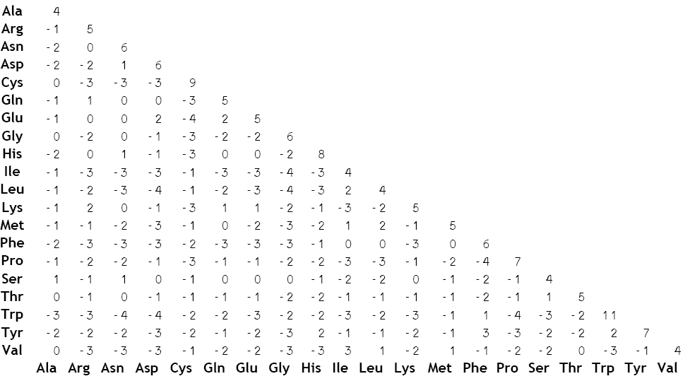
BLOSUM62 matrix
http://upload.wikimedia.org/wikipedia/commons/5/52/BLOSUM62.gif

Slide 35
BLAST: Step 2
Use substitution matrix to find synonymous words about some scoring threshold
http://www.plosbiology.org/article/info%3Adoi%2F10.1371%2Fjournal.pbio.1001014

Slide 36
BLAST: Step 3
Find matching words in the database
Extend word matches between query and matching sequence in both directions until extension score drops below threshold
First without gaps
http://www.plosbiology.org/article/info%3Adoi%2F10.1371%2Fjournal.pbio.1001014

Slide 37
BLAST: Step 4
If initial alignment good enough, redo with gaps and calculate statistics
http://www.plosbiology.org/article/info%3Adoi%2F10.1371%2Fjournal.pbio.1001014

Slide 38
BLAST score
Penalty for
opening gap
Per-residue for gap extension
$$S= \left(\sum{M_{ij}}\right)−cO−dG$$
Score
Sum of scores from distance matrix
# of gaps
Total length
of gaps
Gap opening penalty typically significantly larger than gap extension penalty
Why?

Slide 39
Questions:
Why do gap opening and extension penalties differ?
Why is BLAST a local aligner vs. global

Slide 40
Local alignment
Sequence extensions do not necessarily extend to sequence ends
Domains vs entire proteins
Can be multiple query->reference matches
i.e., alignment can be broken, each with own statistics
Can be multiple reference matches to the same query

Slide 41
Sequence masking
Low-complexity regions can arise convergently
Small hydrophobic amino acids common in transmembrane helices
Violates homology assumption, therefore often excluded from BLAST search

Slide 42
Comparing BLAST scores
Different BLASTs can use different parameters, e.g., matrices & gap penalties
“Bit scores” normalize for this
$$S^{′}= \left(λS−\ln{K}\right)/\ln{2}$$
Bit score
Matrix
penalty
Gap
penalty
Score

Slide 43
E-values
What is the likelihood that the sequence similarity is due to chance vs. actual homology?
Larger databases are more likely to include chance matches

Slide 44
E-values
Length of the query sequence
Bit score
$$E=\left(n×m\right)/\left(2^{S^{′}}\right)$$
E-value
Total # of residues in the database

Slide 45
E-values
The E-value represents the likelihood of a random match >= the calculated score
Smaller E-values therefore reflect greater probability of true homology
Typically 1e⁻⁵ operationally used as a threshold for considering sequences as homologous

Slide 46
Summary
Wednesday: applying BLAST
Next week: expanding from one->many sequence comparisons to many->many

