Slide 1
MCB5472
Computer methods in molecular evolution
Lecture 3/31/2014

Slide 2
Discussion of Strand Bias

Slide 3
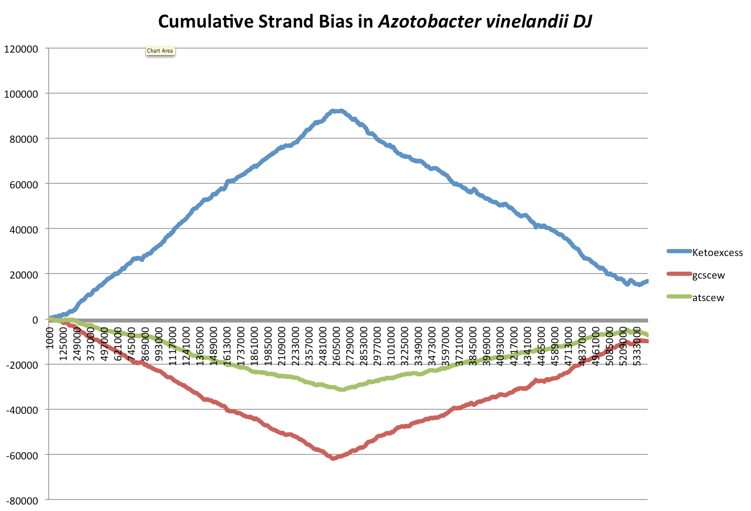

Slide 4
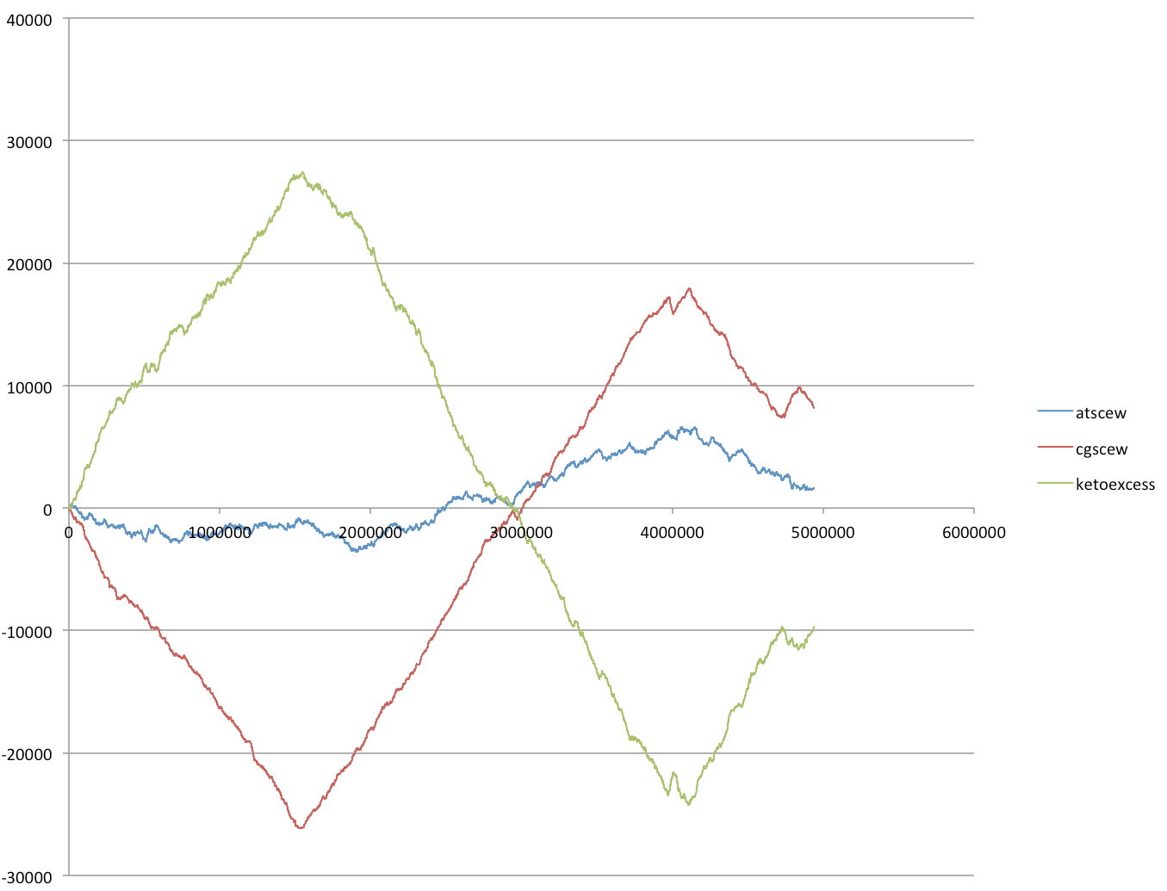
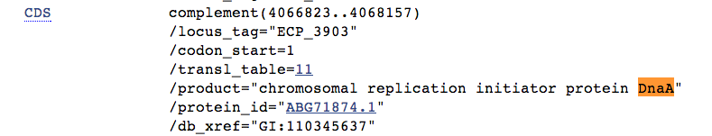
gi|110640213|ref|NC_008253.1| Escherichia coli 536

Slide 5
Clostridium difficile complete genome, strain 2007855

Slide 6
DnaA is the 1st ORF

Slide 7
Old assignements

Slide 8
Old assignements
Write a script that prints out a hash sorted on the keys in alphabetical order.
How can you remove an entry in a hash (key and value)?
Write a program that it uses hashes to calculates mono-, di-, tri-, and quartet-nucleotide frequencies in a genome.
Turn your project outline into a step by step to-do list / pseudocode

Slide 9
Answers to old exercises:
Write a script that determines the number of elements in %ash.
@keys = keys(%ash); #assigns keys to an array
$number =@keys;
# determines number of different keys (uses array in scalar context).
print "$number \n";
Write a script that prints out a hash sorted on the keys in alphabetical order.
@gi_names = sort(keys(%gi_hash));
# sorts key and assigns keys to an array
foreach (@gi_names){
print "$_ occurred $gi_hash{$_} times\n";
}
Remove an entry in a hash (key and value):
delete $gi_hash{$varaible_denoting_some_key};

Slide 10
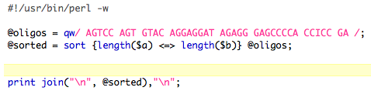
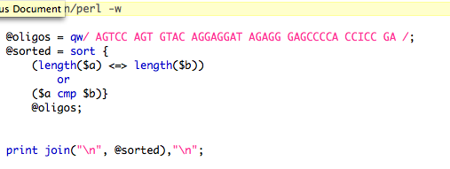
Sort based on code {}
see P10 on qw/ .../
or
See P11 in Unix Perl Primer on sort

Slide 11
To sort Keys by their value:
or

Slide 12
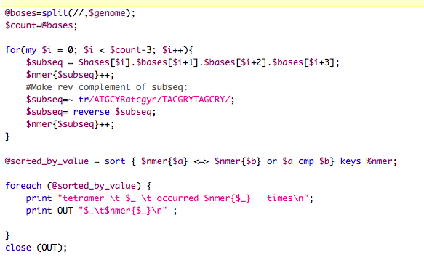
Answers to old exercises:
Write a program that it uses hashes to calculates mono-, di-, tri-, and quartet-nucleotide frequencies in a genome.
For 4-mer
Read in genome ($genome), then
See P9 on uning arrays in scalar context.

Slide 13
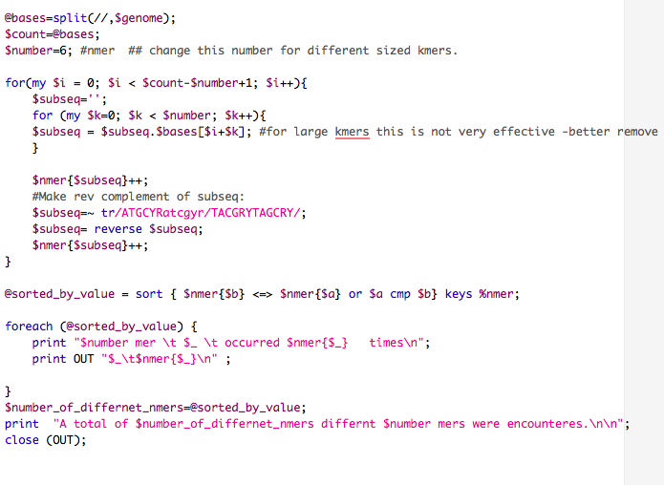
Answers to old exercises:
Write a program that it uses hashes to calculates mono-, di-, tri-, and quartet-nucleotide frequencies in a genome.
For n-mer

Slide 14
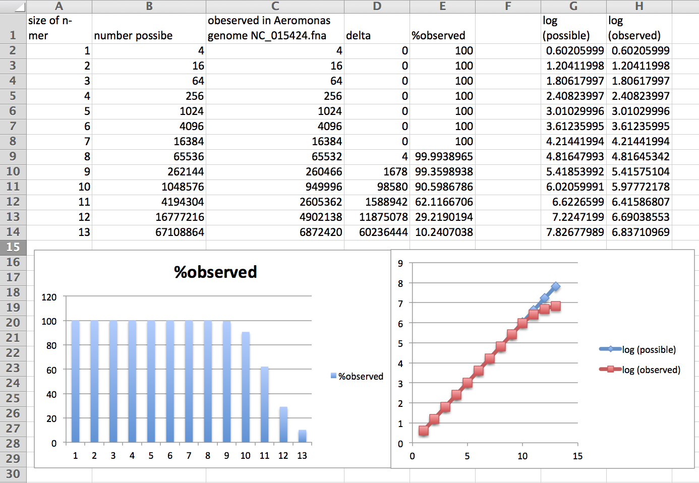

Slide 15
GCCAGC
GCTGGC
16090
CTAGTA 124
TACTAG 124

Slide 17
assignments continued
Old assignements
Assume that you have the following non-aligned multiple sequence files in a directory:
A.fa : vacuolar/archaeal ATPase catalytic subunits ;
B.fa : vacuolar/archaeal ATPase non-catalytic subunits;
alpha.fa : F-ATPases non-catalytic subunits,
beta.fa : F-ATPases catalytic subunits,
F.fa : ATPase involved in the assembly of the bacterial flagella.
Write a perl script that executes muscle or clustalw2 and
aligns the sequences within each file
successively calculates profile alignments between all aligned sequences.

Slide 18
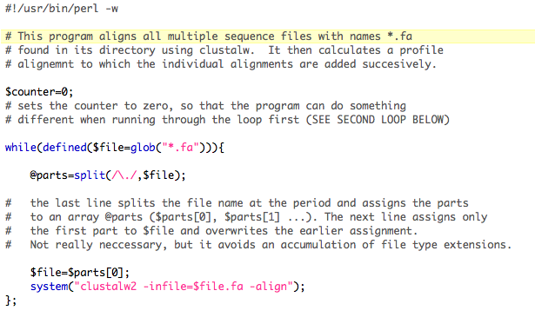
First loop: Calculate multiple alignments for all *.fa files
This results in one *.aln file per *.fa file
Using muscle the command would something like
system(“muscle –in $file.fa -out $file.aln”);
Muscle manual at http://www.drive5.com/muscle/muscle.html

Slide 19
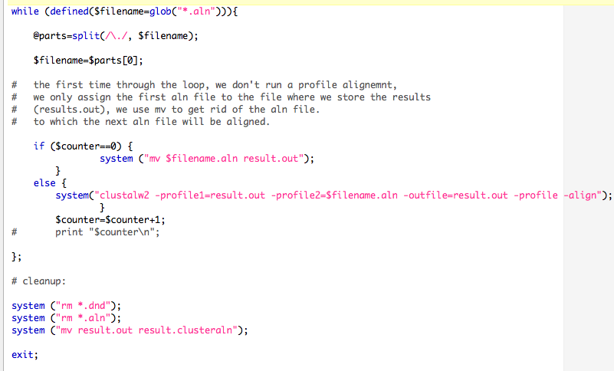
Take *.aln files and add them successively to growing alignment
Using muscle:
system (“muscle -profile -in1 result.out -in2 $filename.aln –out result.out”);

Slide 20
Questions?
Rooting molecular phylogenies
Terminology Cladistics and a Natural Taxonomy
What should one make of the claim that a monophyletic group traces back to a single ancestor? (Mitochondrial Eve had about 10000 sisters living at the same time, and they all contributed to the gene pool of current humans.
How can one mislead less experienced readers in depicting trees?

Slide 21
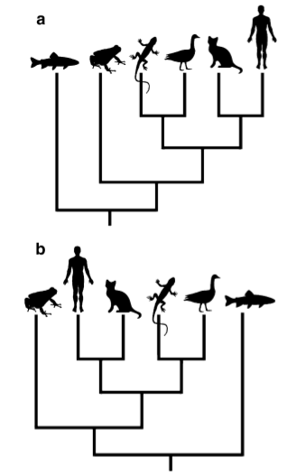
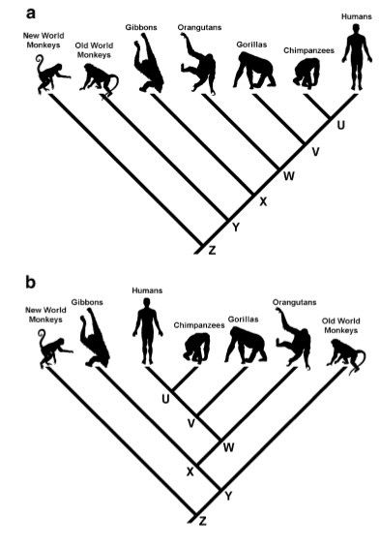
Link to citation see next slide

Slide 22
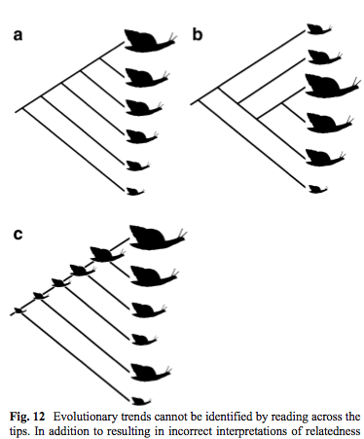
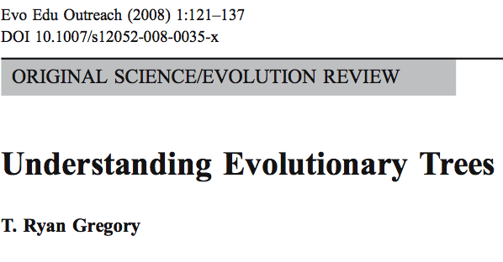
From
Also see the link to trees and their topology here

Slide 23
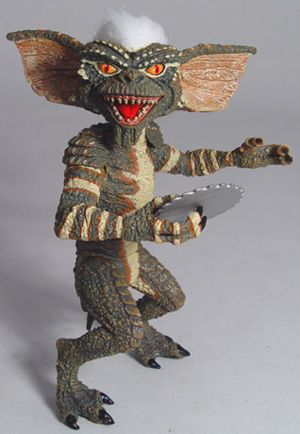
Elliot Sober’s Gremlins
Observation: Loud noise in the attic
?
Hypothesis: gremlins in the attic playing bowling
Likelihood =
P(noise|gremlins in the attic)
P(gremlins in the attic|noise)
?
?

Slide 24

Bayes’ Theorem
Likelihood
describes how well the model predicts the data
P(data|model, I)
P(model|data, I) = P(model, I)
P(data,I)
Posterior
Probability
represents the degree
to which we believe a given model accurately describes the situation
given the available data and all of our prior information I
Prior
Probability
describes the degree to which we believe the model accurately describes reality
based on all of our prior information.
Normalizing
constant
Reverend Thomas Bayes (1702-1761)

Slide 25
Likelihood estimates do not take prior information into consideration:
e.g., if the result of three coin tosses is 3 times head, then the likelihood estimate for the frequency of having a head is 1 (3 out of 3 events) and the estimate for the frequency of having a tail is zero.
The probability that both events (A and B) occur
Both sides expressed as conditional probability
If A is the model and B is the data, then
P(B|A) is the likelihood of model A
P(A|B) is the posterior probability of the model given the data.
P(A) is the considered the prior probability of the model.
P(B) often is treated as a normalizing constant.

Slide 26
Alternative Approaches to Estimate
Posterior Probabilities
Bayesian Posterior Probability Mapping with MrBayes
(Huelsenbeck and Ronquist, 2001)
Problem:
Strimmer’s formula
L_{i}
p_{i}=
only considers 3 trees
(those that maximize the likelihood for
the three topologies)
L₁+L₂+L₃
Solution:
Exploration of the tree space by sampling trees using a biased random walk
(Implemented in MrBayes program)
Trees with higher likelihoods will be sampled more often
N_{i}
p_{i}≈
N_{total}
,where N_{i} - number of sampled trees of topology i, i=1,2,3
N_{total} – total number of sampled trees (has to be large)

Slide 27
Illustration of a biased random walk
Figure generated using MCRobot program (Paul Lewis, 2001)

Slide 28
More reading on Phylogenetics is at
http://en.wikipedia.org/wiki/Computational_phylogenetics

Slide 29
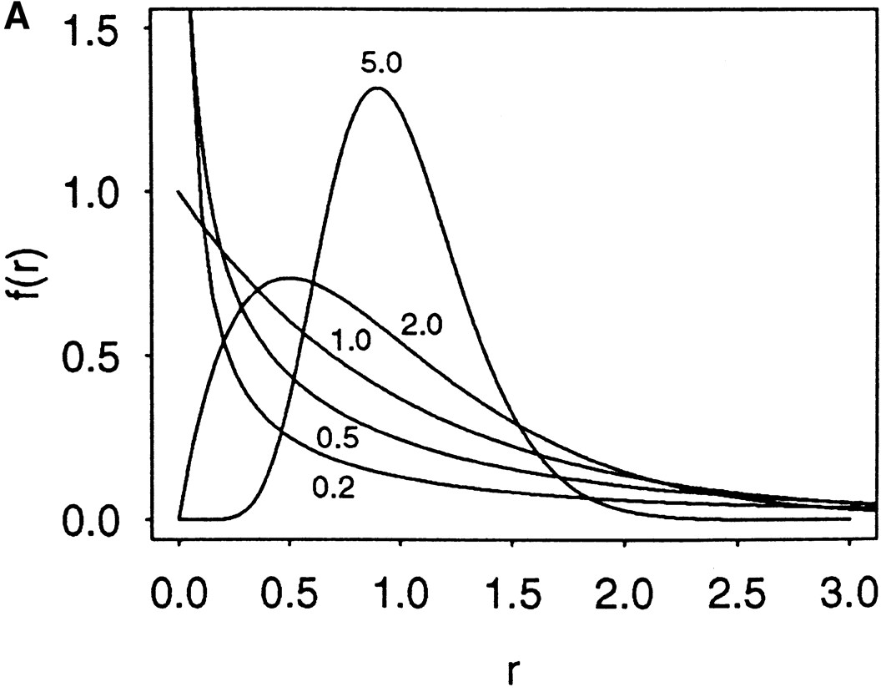

Figure 1. The probability density functions of gamma distributions
Zhang, J. et al. Genetics 1998;149:1615-1625
Copyright © 2007 by the Genetics Society of America

Slide 30
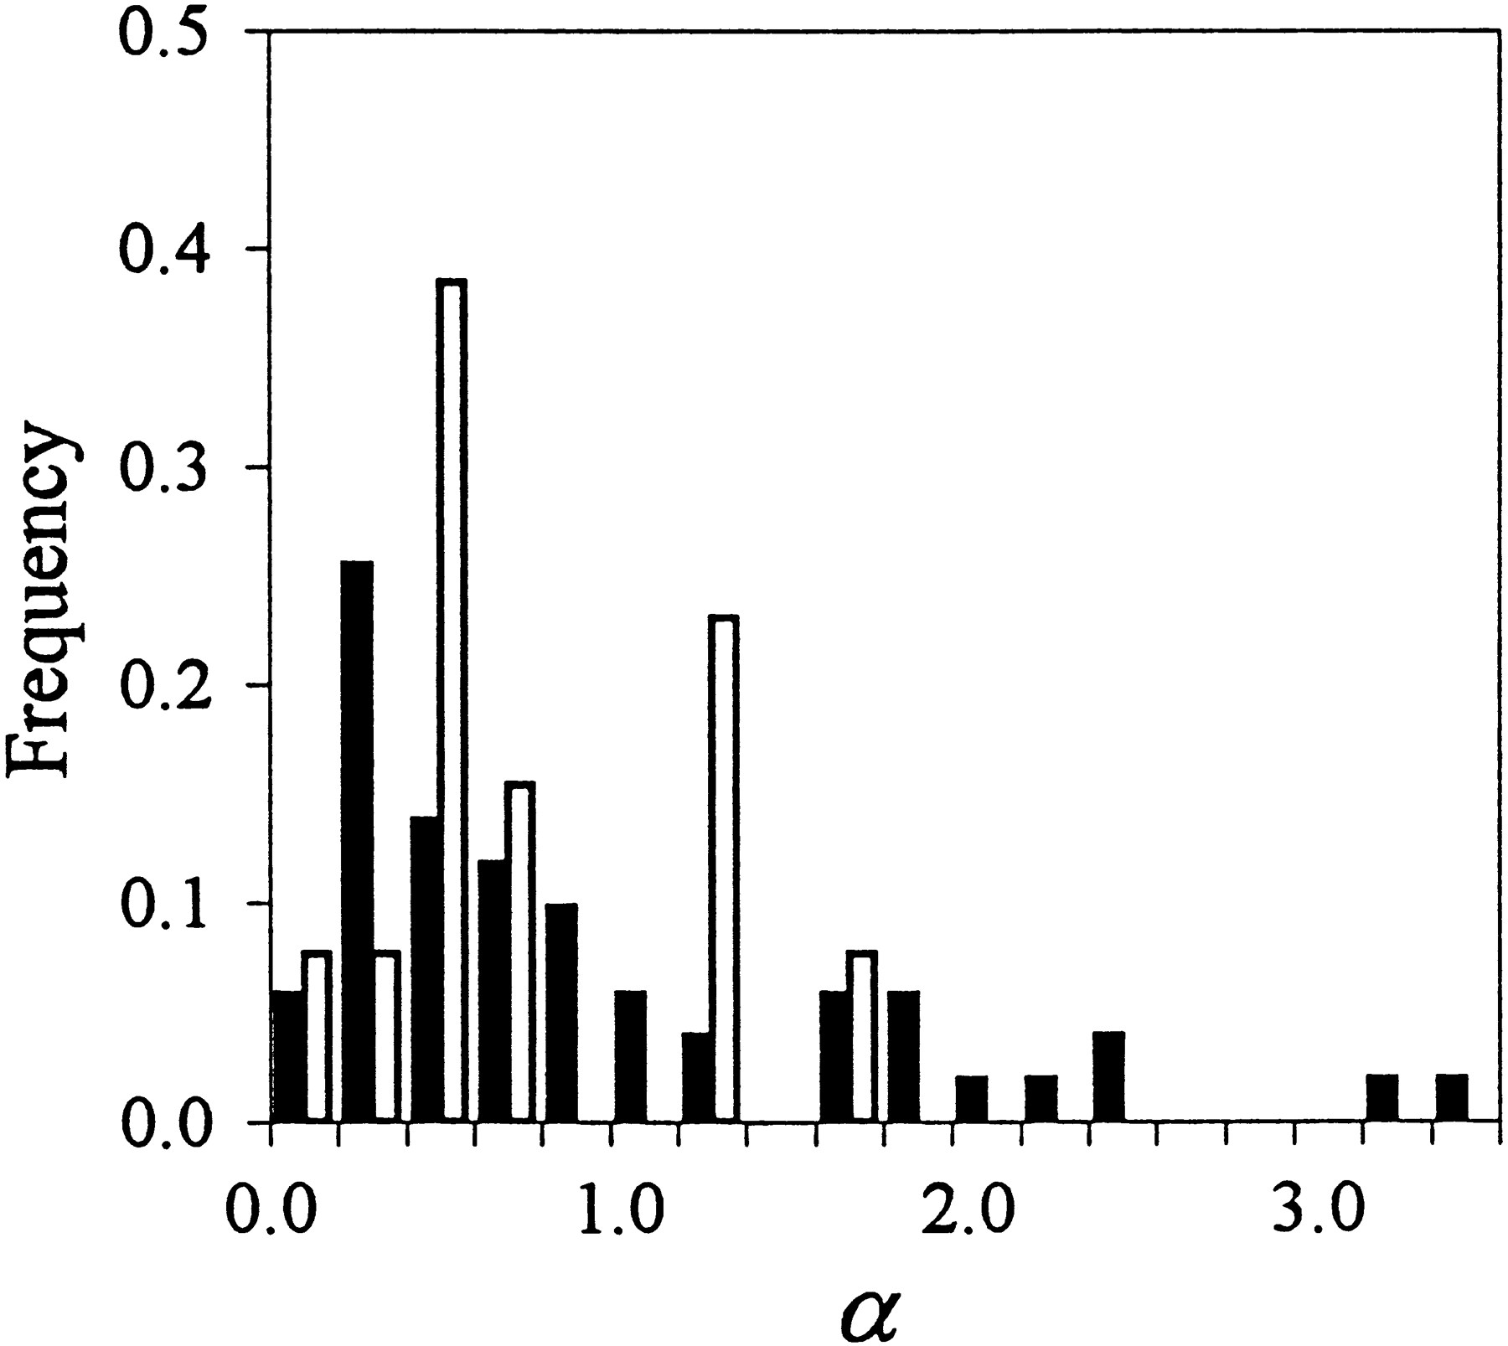
Figure 4. Distributions of the {alpha} values of 51 nuclear (solid histograms) and 13
mitochondrial (open histograms) genes
Zhang, J. et al. Genetics 1998;149:1615-1625
Copyright © 2007 by the Genetics Society of America

Slide 31
Why could a gene tree be different from the species tree?
Lack of resolution
Lineage sorting
Gene duplications/gene loss (paralogs/orthologs)
Gene transfer
Systematic artifacts (e.g., compositional bias and long branch attraction)

Slide 32
Trees – what might they mean?
Calculating a tree is comparatively easy, figuring out what it might mean is much more difficult.
If this is the probable organismal tree:
species A
species B
species C
species D
what could be the reason for obtaining this gene tree:
seq. from A
seq. from D
seq. from C
seq. from B

Slide 33
lack of resolution
seq. from A
seq. from D
seq. from C
seq. from B
e.g., 60% bootstrap support for bipartition (AD)(CB)

Slide 34
long branch attraction artifact
the two longest branches join together
seq. from A
seq. from D
seq. from C
seq. from B
e.g., 100% bootstrap support for bipartition (AD)(CB)
What could you do to investigate if this is a possible explanation?
use only slow positions,
use an algorithm that corrects for ASRV

Slide 35
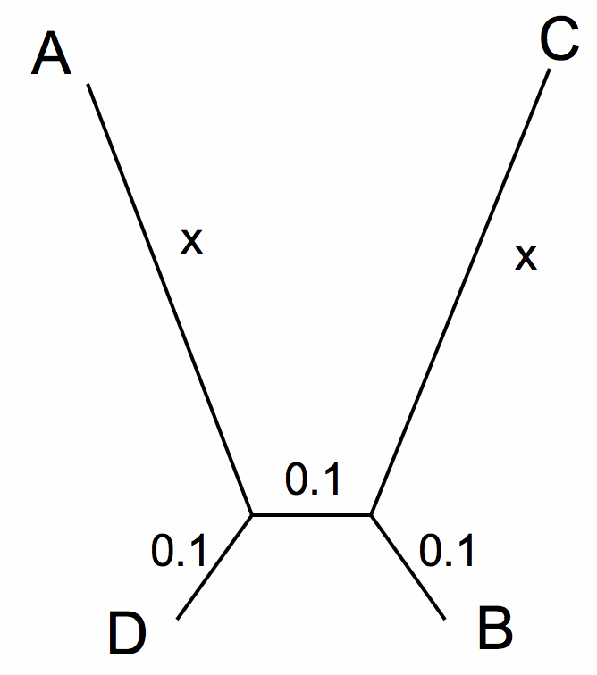
LBA
ProtPars

Slide 36
LBA
Prot Dist no Gamma and no alignment

Slide 37
LBA
Prot Dist with Gamma and no alignment

Slide 38
LBA
Prot Dist with Gamma and alignment

Slide 39
Gene transfer
Organismal tree:
species A
species B
Gene Transfer
species C
species D
molecular tree:
seq. from A
seq. from D
seq. from C
speciation
seq. from B
gene transfer

Slide 40
Lineage Sorting
Organismal tree:
species A
species B
species C
Genes diverge and coexist in the
organismal lineage
species D
molecular tree:
seq. from A
seq. from D
seq. from C
seq. from B

Slide 41
Gene duplication
Organismal tree:
species A
species B
species C
gene duplication
species D
molecular tree:
molecular tree:
molecular tree:
seq. from A
seq. from A
seq. from A
seq. from B
seq. from B
seq. from C
seq. from C
seq. from D
seq. from D
seq. from D
seq.’ from B
seq.’ from B
seq.’ from C
seq.’ from C
seq.’ from C
gene duplication
gene duplication
gene duplication
seq.’ from D
seq.’ from D
seq.’ from D

Slide 42
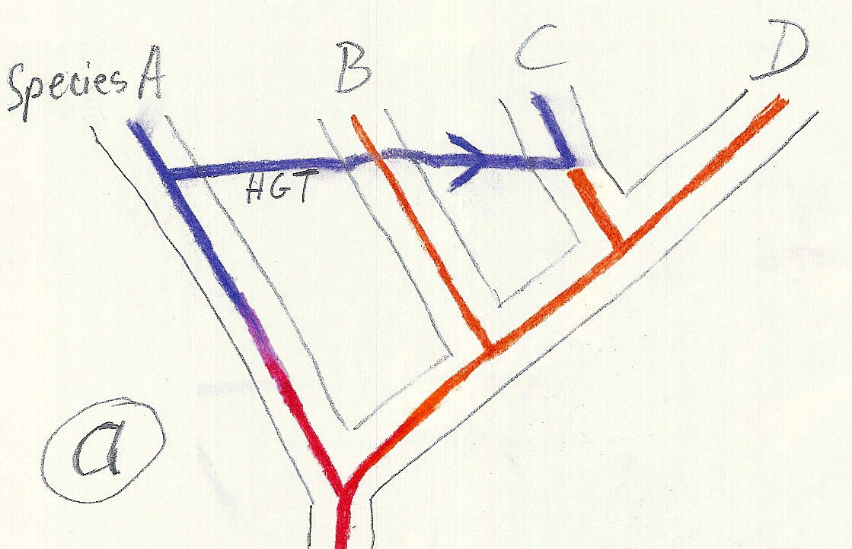
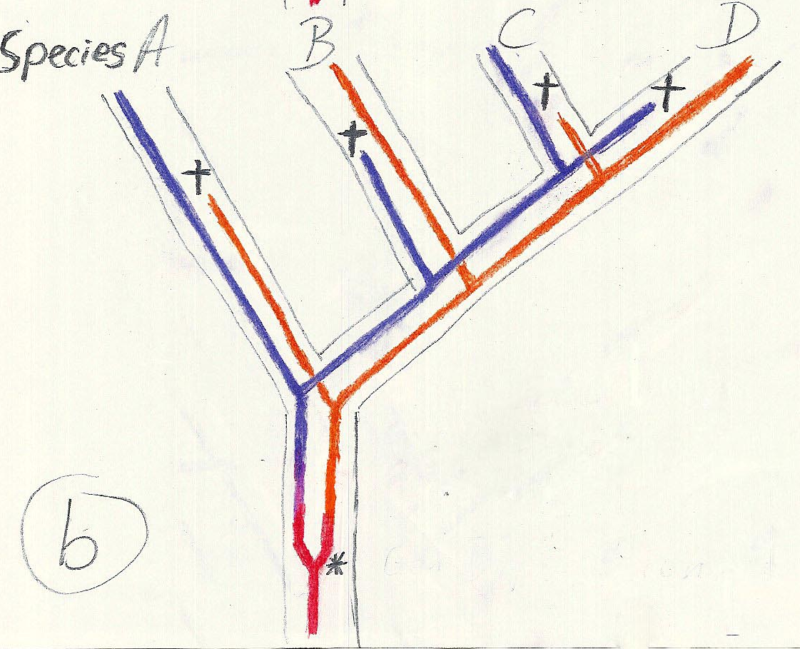
Gene duplication and gene transfer are equivalent explanations.
The more relatives of C are found that do not have the blue type of gene, the less likely is the duplication loss scenario
Ancient duplication followed by gene loss
Horizontal or lateral Gene
Note that scenario B involves many more individual events than A
1 HGT with
orthologous replacement
1 gene duplication followed by 4 independent gene loss events

Slide 43
Function, ortho- and paralogy
molecular tree:
seq. from A
seq.’ from B
seq.’ from C
seq.’ from D
gene duplication
seq. from B
seq. from C
seq. from D
The presence of the duplication is a taxonomic character (shared derived character in species B C D).
The phylogeny suggests that seq’ and seq have similar function, and that this function was important in the evolution of the clade BCD.
seq’ in B and seq’in C and D are orthologs and probably have the same function, whereas seq and seq’ in BCD probably have different function (the difference might be in subfunctionalization of functions that seq had in A. – e.g. organ specific expression)

Slide 44
Phylip
written and distributed by Joe Felsenstein and collaborators (some of the following is copied from the PHYLIP homepage)
PHYLIP (the PHYLogeny Inference Package) is a package of programs for inferring phylogenies (evolutionary trees).
PHYLIP is the most widely-distributed phylogeny package, and competes with PAUP* to be the one responsible for the largest number of published trees. PHYLIP has been in distribution since 1980, and has over 15,000 registered users.
Output is written onto special files with names like "outfile" and "outtree". Trees written onto "outtree" are in the Newick format, an informal standard agreed to in 1986 by authors of a number of major phylogeny packages.
Input is either provided via a file called “infile” or in response to a prompt.

Slide 45
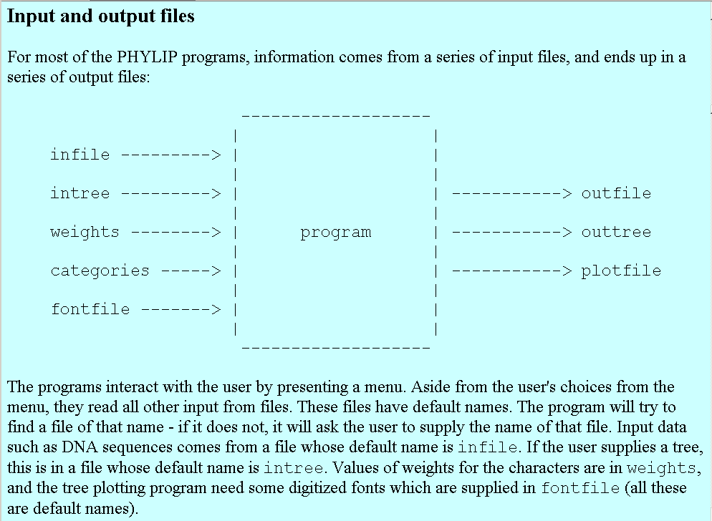
input and output

Slide 46
What’s in PHYLIP
Programs in PHYLIP allow to do parsimony, distance matrix, and likelihood methods, including bootstrapping and consensus trees. Data types that can be handled include molecular sequences, gene frequencies, restriction sites and fragments, distance matrices, and discrete characters.
Phylip works well with protein and nucleotide sequences
Many other programs mimic the style of PHYLIP programs.
(e.g. TREEPUZZLE, phyml, protml)
Many other packages use PHYIP programs in their inner workings (e.g., PHYLO_WIN)
PHYLIP runs under all operating systems
Web interfaces are available

Slide 47
Programs in PHYLIP are Modular
For example:
SEQBOOT take one set of aligned sequences and writes out a file containing bootstrap samples.
PROTDIST takes a aligned sequences (one or many sets) and calculates distance matices (one or many)
FITCH (or NEIGHBOR) calculate best fitting or neighbor joining trees from one or many distance matrices
CONSENSE takes many trees and returns a consensus tree
…. modules are available to draw trees as well, but often people use treeview or njplot

Slide 48
The Phylip Manual
is an excellent source of information.
Brief one line descriptions of the programs are here
The easiest way to run PHYLIP programs is via a command
line menu (similar to clustalw). The program is invoked through clicking on an icon, or by typing the program name at the command line.
> seqboot
> protpars
> fitch
If there is no file called infile the program responds with:
[gogarten@carrot gogarten]$ seqboot
seqboot: can't find input file "infile"
Please enter a new file name>

Slide 49
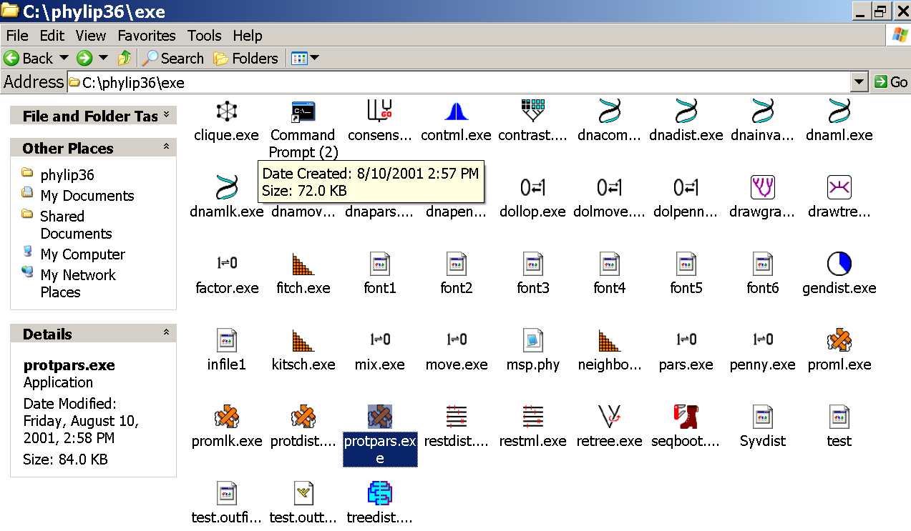
program folder

Slide 50
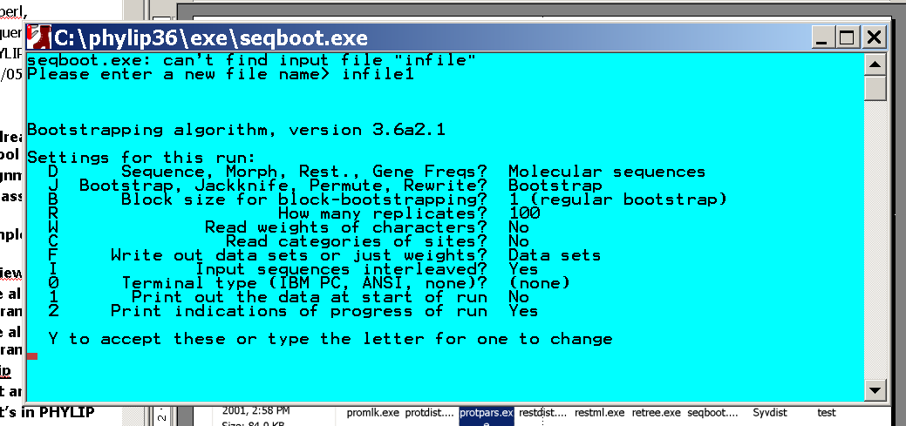
menu interface
example: seqboot and protpars on infile1

Slide 51
Sequence alignment:
CLUSTALW
MUSCLE
Removing ambiguous positions:
T-COFFEE
FORBACK
Generation of pseudosamples:
SEQBOOT
PROTDIST
TREE-PUZZLE
Calculating and evaluating phylogenies:
PROTPARS
PHYML
NEIGHBOR
FITCH
Comparing phylogenies:
CONSENSE
SH-TEST in TREE-PUZZLE
Comparing models:
Maximum Likelihood Ratio Test
Visualizing trees:
ATV, njplot, or treeview
Phylip programs can be combined in many different ways with one another and with programs that use the same file formats.

Slide 52
Example 1 Protpars
example: seqboot, protpars, consense on atp_all.phy
NOTE the bootstrap majority consensus tree does not necessarily have the same topology as the “best tree” from the original data!
threshold parsimony,
gap symbols - versus ?
(in vi you could use :%s/-/?/g to replace all – ?)
outfile
outtree compare to distance matrix analysis

Slide 53
hints
Rather than typing commands at the menu, you can write the responses that you would need to give via the keyboard into a file (e.g. your_input.txt)
You could start and execute the program protpars by typing
protpars < your_input.txt
your input.txt might contain the following lines:
  infile1.txt
  r
  t
  10
  y
  r
  r
in the script you could use the line
system (“protpars < your_input.txt”);
The main problem are the owerwrite commands if the oufile and outtree files are already existing. You can either create these beforehand, or erase them by moving (mv) their contents somewhere else.

Slide 54
Alternative for entering the commands for the menu:
#!/usr/bin/perl -w
system ("cp A.phy infile");
system ("echo -e 'y\n9\n'|seqboot");
exit;
echo returns the string in ‘ ‘, i.e., y\n9\n.
The –e options allows the use of \n
The | symbol pipes the output from echo to seqboot

Slide 55
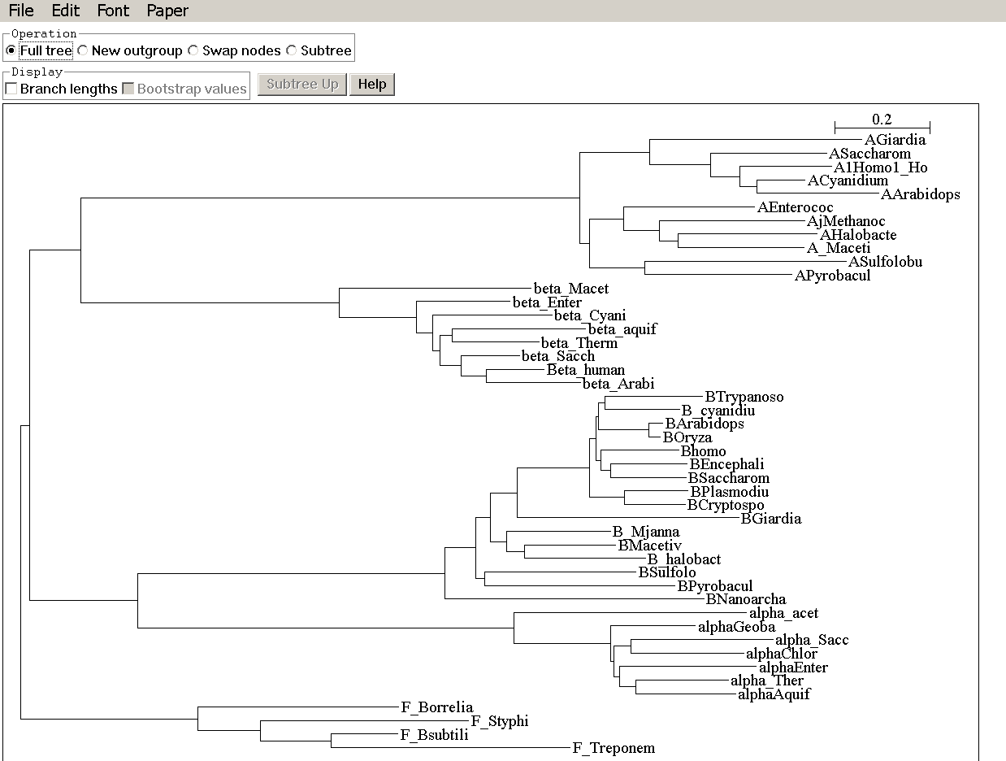
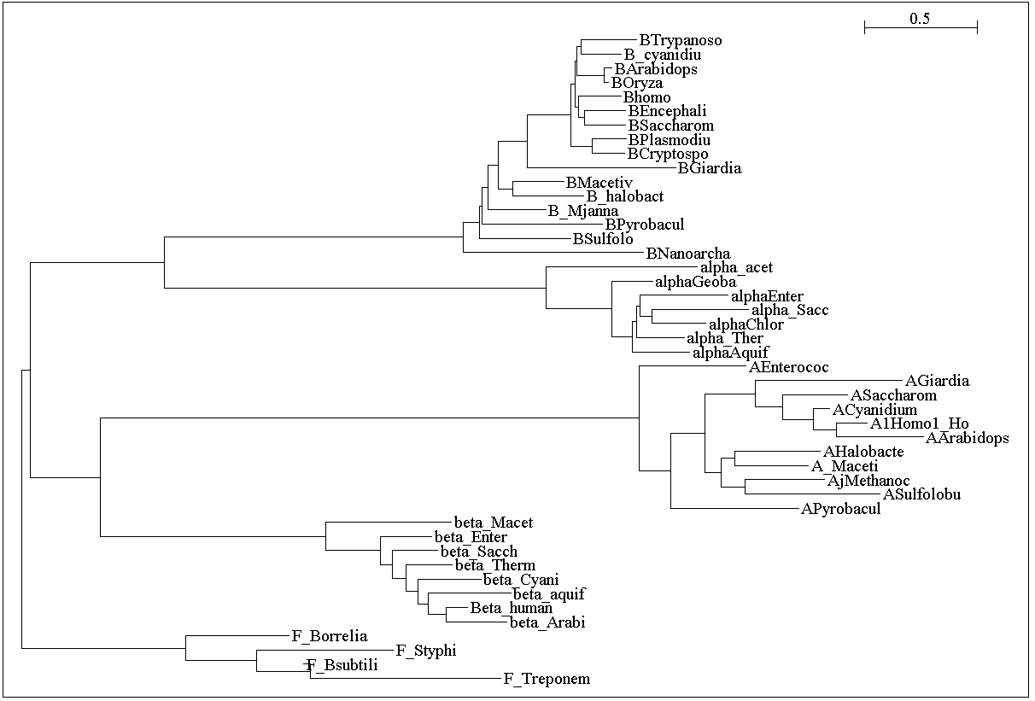
without and with correction for ASRV

Slide 56
phyml
PHYML - A simple, fast, and accurate algorithm to estimate large phylogenies by maximum likelihood
An online interface is here ;
The program manual is here.
There is a command line version that is described here (not as straight forward as in clustalw);
a phylip like interface is automatically invoked, if you type
“phyml” – the manual is here.
Phyml is installed on bbcsrv3.
Do example on atp_all.phy
Note data type, bootstrap option within program, models for ASRV (pinvar and gamma), by default the starting tree is calculated via neighbor joining.

Slide 57
Assignment
Write a script that takes all phylip formated aligned multiple sequence files present in a directory, and performes a bootstrap analyses using maximum parsimony.
Files you might want to use are A.fa, B.fa, alpha.fa, beta.fa from last week’s assignment, and atp_all.phy. BUT you first have to align them and convert them to phylip format* AND you should replace gaps with “?”
(In the end you would be able to answer the question
“does the resolution increase if a more related subgroup is
analyzed independent from an outgroup?)
clustalw2 is one program frequently used to convert formats
system("clustalw -infile=$file.fa –convert -output=PHYLIP");

