Slide 1
MCB5472
Computer methods in molecular evolution
Lecture 4/21/2014

Slide 2
Signup sheet for presentations
https://docs.google.com/spreadsheet/ccc?key=0AjJsMXOC-NEVdEhuenJ3bFEwdUJRUno1alg0aVlvcEE&usp=sharing

Slide 3

sites versus branches
You can determine omega for the whole dataset; however, usually not all sites in a sequence are under selection all the time.
PAML (and other programs) allow to either determine omega for each site over the whole tree, ,
or determine omega for each branch for the whole sequence,
.
It would be great to do both, i.e., conclude codon 176 in the vacuolar ATPases was under positive selection during the evolution of modern humans – alas, a single site does not provide much statistics ….

Slide 4
ML Ratio test
In case of two nested models that differ by n parameters, one can test if the increase in likelihood (=probability of the data) is significant, i.e., more than expected from having an additional parameter.
E.g., phylogenetic tree with and without clock. In this case, the model without clock is the more complex model, that has n-1 more parameters (the branch lengths leading to the leaves) than the clock model.
Using the atp_all.phy example from tree-puzzle

Slide 5
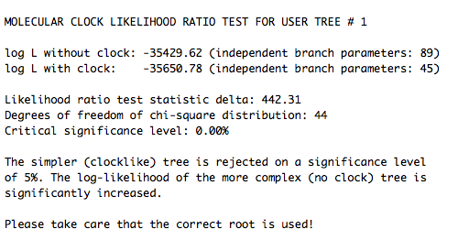
ML Ratio test
atp_all.phy example from tree-puzzle
go through outfile_atp_all_puzzle_clock.out (at
http://gogarten.uconn.edu/mcb5472_2014/outfile_atp_all_puzzle_clock.out

Slide 6
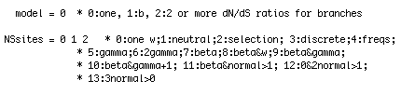
ML Ratio test
codeml example hv1.phy
Control file
Output file:
http://gogarten.uconn.edu/mcb5472_2014/Hv1.sites.codeml.out

Slide 7
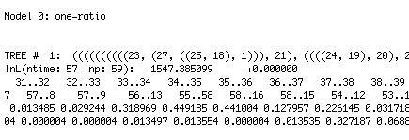
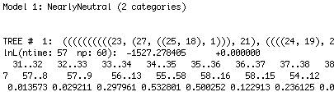
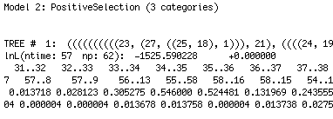
ML Ratio test
codeml example hv1.phy
output file
1 df
2*delta logL=
2*(1547.395-1527.278)=
40.234

Slide 8
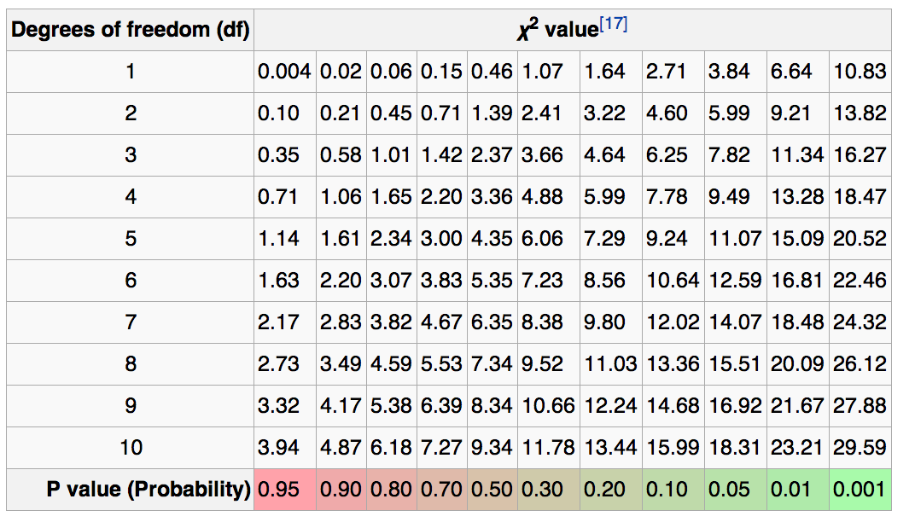
40 is way off the table
The improvement in fit, when sites under neutral and under purifying selection are allowed is very significant (P<<0.0001)

Slide 9
ML Ratio test
codeml example hv1.phy
output file
1 df
2*delta logL=
2*(1527.278-1525.590)=
3.376

Slide 10
3.37 with 1 df
The improvement in fit, when sites under positive (diversifying selection are added is not significant (P>0.05)

Slide 11
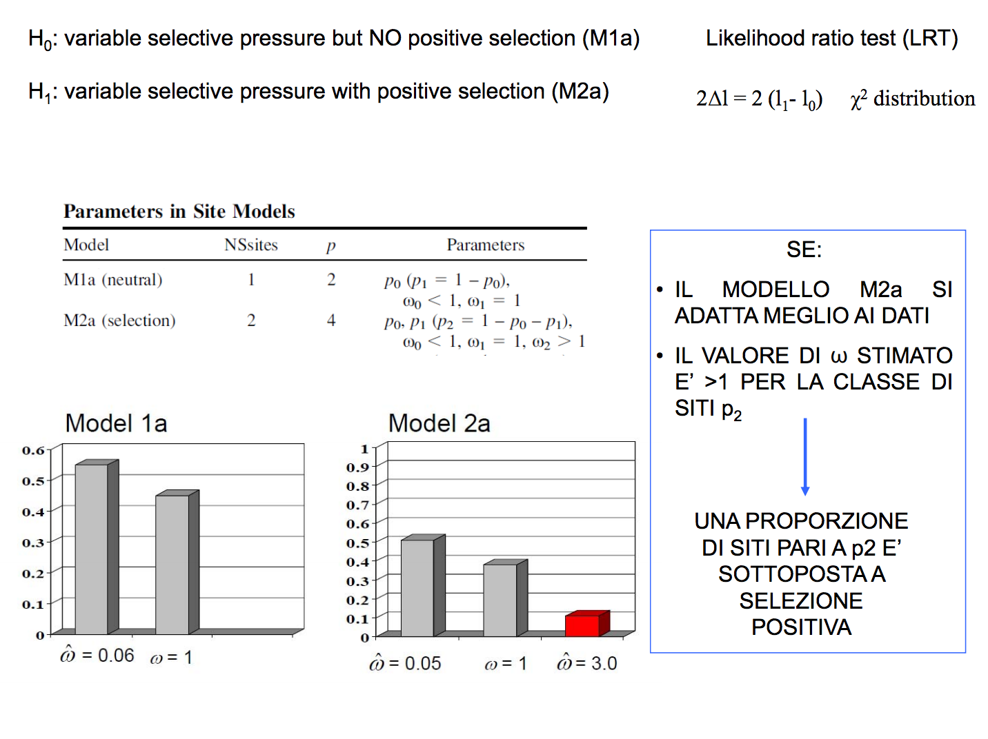
From: http://m.docente.unife.it/silvia.fuselli/dispense-corsi/EM_Lezione%208.pdf

Slide 12
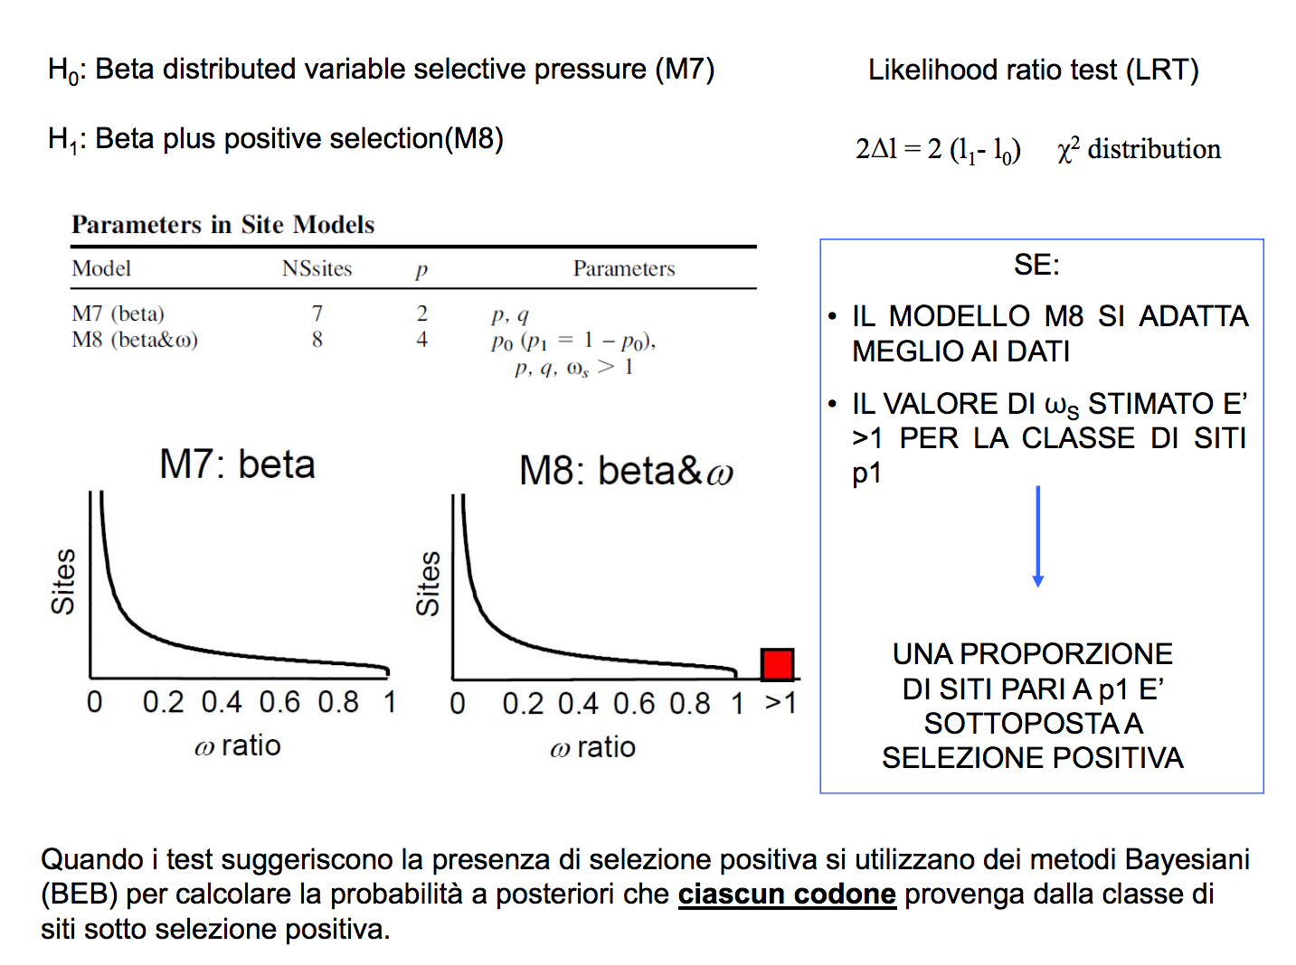
From: http://m.docente.unife.it/silvia.fuselli/dispense-corsi/EM_Lezione%208.pdf

Slide 13
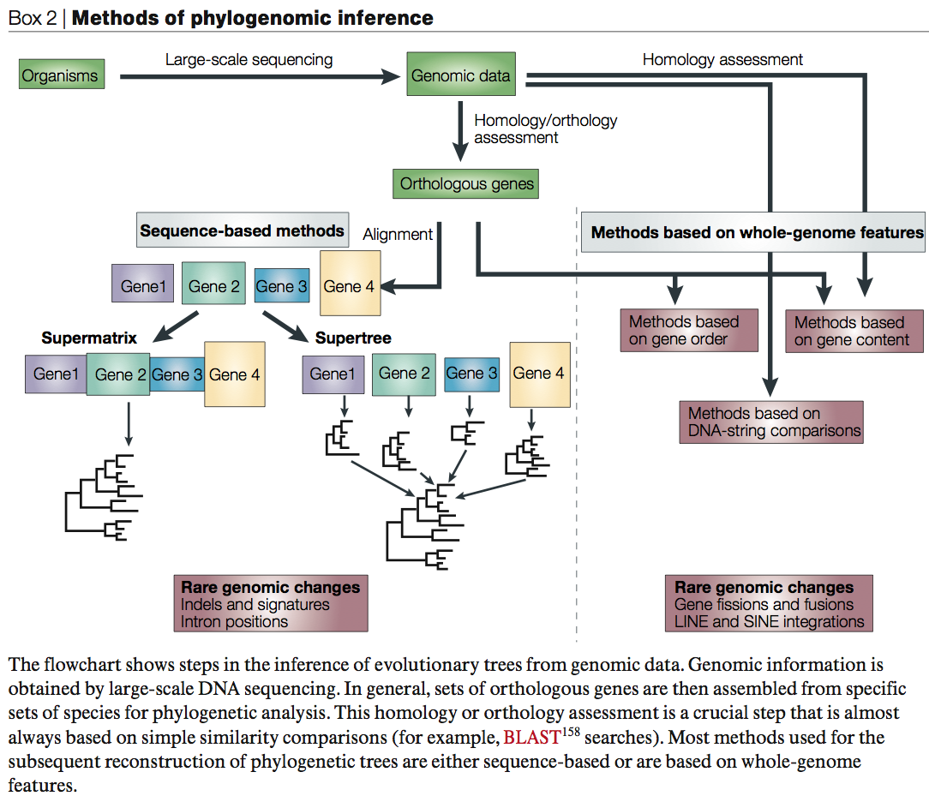
From:
Delsuc F, Brinkmann H, Philippe H.
Phylogenomics and the reconstruction of the tree of life.
Nat Rev Genet. 2005 May;6(5):361-75.

Slide 14
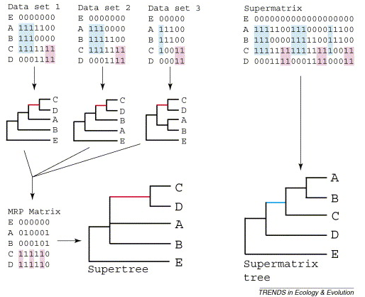
Supertree vs. Supermatrix
From:
Alan de Queiroz John Gatesy:
The supermatrix approach to systematics
Trends Ecol Evol. 2007 Jan;22(1):34-41
Schematic of MRP supertree (left) and parsimony supermatrix (right) approaches to the analysis of three data sets. Clade C+D is supported by all three separate data sets, but not by the supermatrix. Synapomorphies for clade C+D are highlighted in pink. Clade A+B+C is not supported by separate analyses of the three data sets, but is supported by the supermatrix. Synapomorphies for clade A+B+C are highlighted in blue. E is the outgroup used to root the tree.

Slide 15
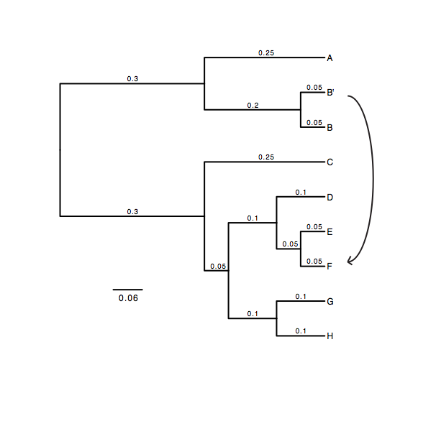
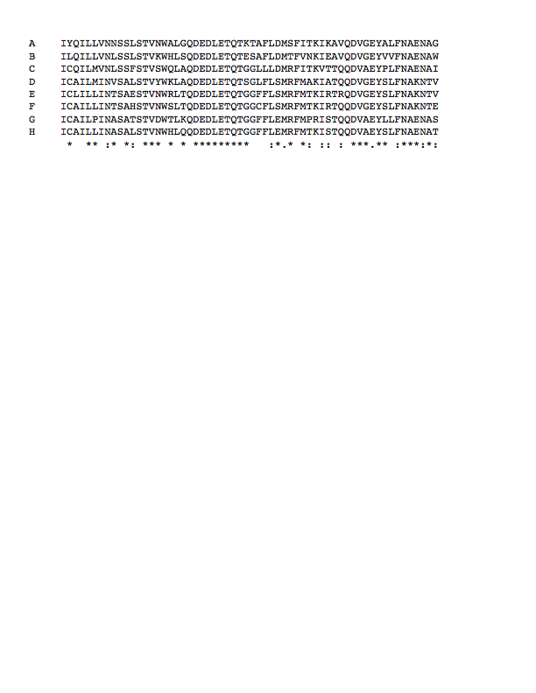
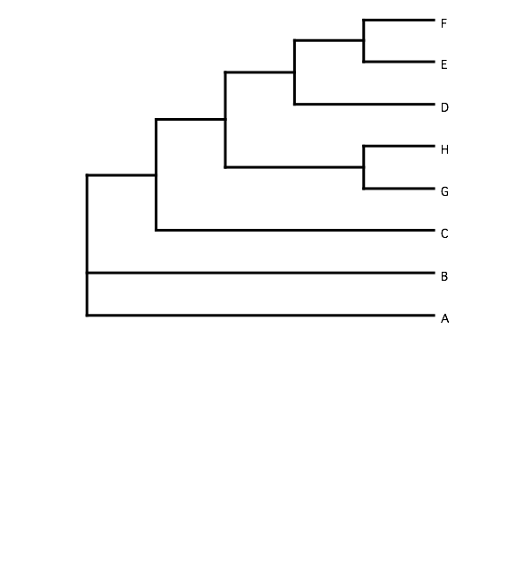
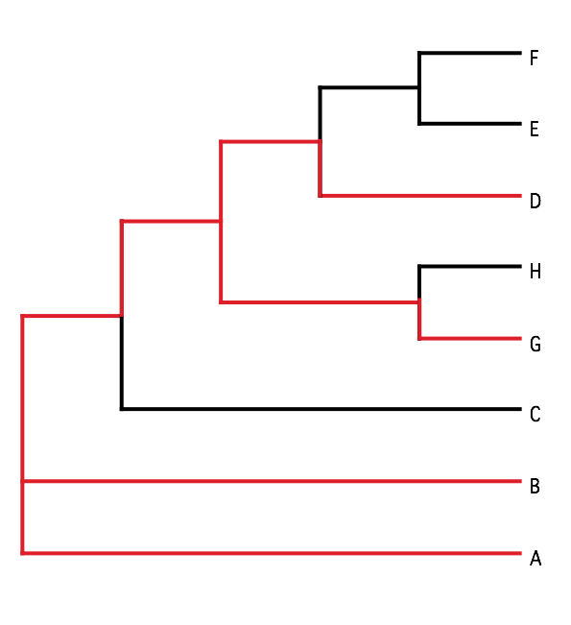
B) Generate 100 datasets using Evolver with certain amount of HGTs
A) Template tree
C) Calculate 1 tree using the concatenated dataset or 100 individual trees
D) Calculate Quartet based tree using Quartet Suite
Repeated 100 times…

Slide 16
Supermatrix versus
Quartet based Supertree
inset: simulated phylogeny

Slide 17
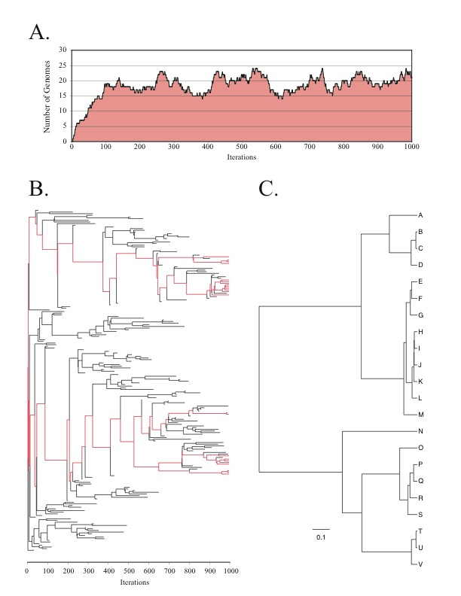
Note : Using same genome seed random number will reproduce same genome history

Slide 18
HGT EvolSimulator Results

Slide 20
See http://bib.oxfordjournals.org/content/15/1/79.full for more information
What is the bottom line?

Slide 21
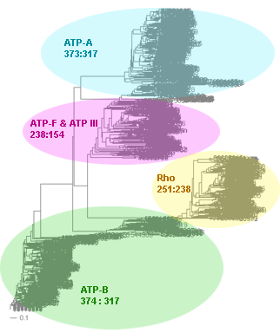
Automated Assembly of Gene Families
Using BranchClust
J. Peter Gogarten
University of Connecticut
Dept. of Molecular and Cell Biol.
Collaborators:
Maria Poptsova (UConn)
Fenglou Mao (UGA)
Funded through the
Edmond J. Safra Bioinformatics Program.
Fulbright Fellowship,
NASA Exobiology Program,
NSF Assembling the Tree of Life Programm and
NASA Applied Information Systems Research Program
Notes:
Title / content
Coauthors
Funding agencies

Slide 22
Why do we need gene families?
Which genes are common between
different species?
Which genes were duplicated in which species?
(Lineage specific gene family expansions)
Do all the common genes share a
common history?
Reconstruct (parts of) the tree/net of life / Detect horizontally transferred genes.

Slide 23
Why do we need gene families?
Help in genome annotation.
Genes in a family should have same annotation across species (usually).
Genes present in almost all genomes of a group of closely related organisms, but absent in one or tow members, might represent genome annotation artifacts.

Slide 24
Selection of Orthologous Gene Families
All automated methods for assembling sets of orthologous genes are based on sequence similarities.
BLAST hits
Triangular circular BLAST significant hits
(COG, or Cluster of Orthologous Groups)
Sequence identity of 30% and greater
(SCOP database)
Similarity complemented by HMM-profile analysis
Pfam database
Reciprocal BLAST hit method

Slide 25
Strict Reciprocal BLAST Hit Method
2’
1
2
1
2
3
4
3
4
1 gene family
0 gene family
often fails in the presence of paralogs

Slide 26
Families of ATP-synthases
Case of 2 bacteria and 2 archaea species
ATP-A (catalytic subunit)
ATP-B (non-catalytic subunit)
Escherichia coli
ATP-A
Escherichia coli
ATP-A
ATP-B
Methanosarcina
mazei
ATP-B
Methanosarcina
mazei
ATP-F
ATP-A
ATP-A
ATP-A
ATP-A
ATP-B
ATP-B
ATP-B
ATP-B
Sulfolobus
solfataricus
Sulfolobus
solfataricus
ATP-A
ATP-A
ATP-B
Bacillus subtilis
ATP-B
ATP-F
Bacillus subtilis
Neither ATP-A nor ATB-B is selected by RBH method

Slide 27
Families of ATP-synthases
Phylogenetic Tree
Family of ATP-A
Sulfolobus solfataricus
ATP-A
Methanosarcina
mazei
Bacillus subtilis
ATP-A
ATP-A
ATP-A
Escherichia coli
Bacillus subtilis
ATP-F
ATP-B
Escherichia coli
ATP-F
Escherichia coli
ATP-B
ATP-B
Bacillus subtilis
ATP-B
Sulfolobus
solfataricus
Family of ATP-F
Methanosarcina
mazei
Family of ATP-B

Slide 28

BranchClust Algorithm
genome 1
genome i
genome 2
BLAST
hits
genome 3
genome N
dataset of N genomes
superfamily
tree
www.bioinformatics.org/branchclust

Slide 29
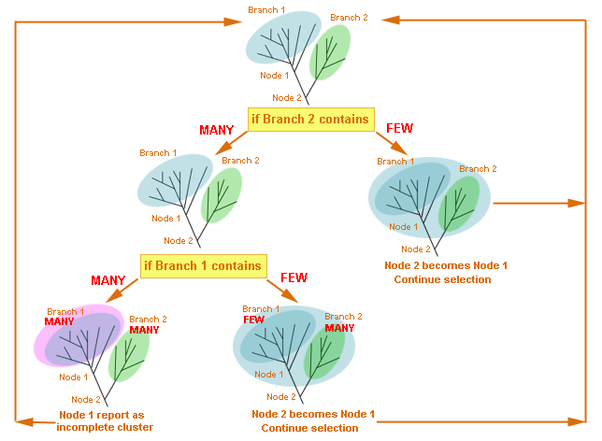
BranchClust Algorithm
www.bioinformatics.org/branchclust

Slide 30
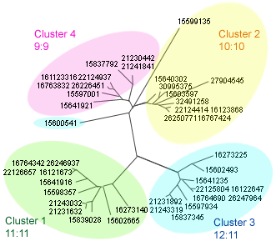
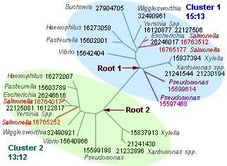
BranchClust Algorithm
Root positions
Superfamily of penicillin-binding protein
Superfamily of DNA-binding protein
13 gamma proteo bacteria
13 gamma proteo bacteria
www.bioinformatics.org/branchclust

Slide 31
BranchClust Algorithm
Comparison of the best BLAST hit method and BranchClust algorithm
Number of taxa - A: Archaea B: Bacteria | Number of selected families:
 | Reciprocal best BLAST hit | BranchClust
2A 2B | 80 | 414 (all complete)
13B | 236 | 409 (263 complete, 409 with n≥8 )
16B 14A | 12 | 126 (60 complete, 126 with n≥24).
www.bioinformatics.org/branchclust

Slide 32
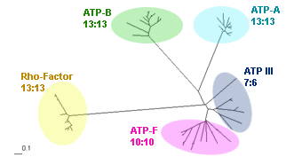
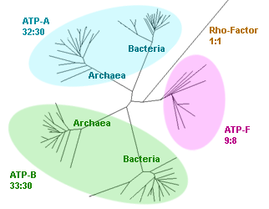
BranchClust Algorithm
ATP-synthases: Examples of Clustering
13 gamma proteobacteria
317 bacteria and archaea
30 taxa: 16 bacteria and 14 archaea
www.bioinformatics.org/branchclust

Slide 33
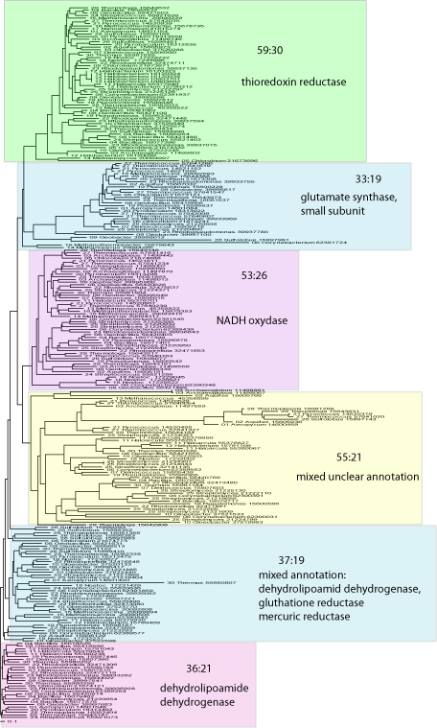
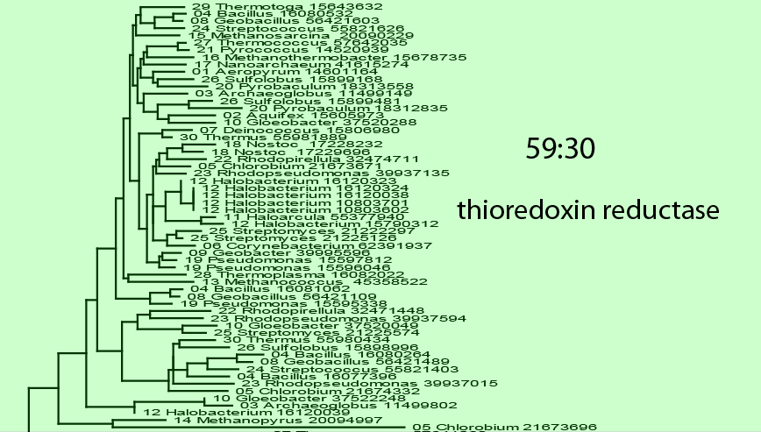
BranchClust Algorithm
Typical Superfamily for 30 taxa (16 bacteria and 14 archaea)
59:30
33:19
53:26
55:21
37:19
36:21
www.bioinformatics.org/branchclust

Slide 34
BranchClust Algorithm
Data Flow
Download n complete genomes (ftp://ftp.ncbi.nlm.nih.gov/genomes/Bacteria)
In fasta format (*.faa)
Align with ClustalW
Reconstruct superfamily tree
ClustalW –quick distance method
Phyml – Maximum Likelihood
Put all n genomes in one database
Search all ORF against database, consisting of n genomes
Parse with BranchClust
Gene families
Parse BLAST-output with the requirement that all members of a superfamily should have an E-value better than a cut-off
Superfamilies
www.bioinformatics.org/branchclust

Slide 35
BranchClust Algorithm
Implementation and Usage
The BranchClust algorithm is implemented in Perl with the use of the BioPerl module for
parsing trees and is freely available at http://bioinformatics.org/branchclust
Required:
1.Bioperl module for parsing trees Bio::TreeIO
2. Taxa recognition file gi_numbers.out must be present in the current directory.
For information on how to create this file, read the Taxa recognition file section on the web-site.
3. Blastall from NCB needs to be installed.
www.bioinformatics.org/branchclust

Slide 36
to use genomes from NCBI:
The easiest source for other genomes is via anonymous ftp from ftp.ncbi.nlm.nih.gov
Genomes are in the subfolder genomes.
Bacterial and Archaeal genomes are in the subfolder Bacteria
For use with BranchClust you want to retrieve the .faa files from the folders of the individual organisms (in case there are multiple .faa files, download them all and copy them into a single file).
Copy the genomes into the fasta folder in directory where the branchclust scripts are.
To create a table that links GI numbers to genomes run perl extract_gi_numbers.pl or
qsub extract_gi_numbers.sh

Slide 37
If you use other genomes you will need to generate a file that contains assignments between name of the ORF and the name of the genome. This file should be called gi_numbers.out
If your genomes follow the JGI convention, every ORF starts with four letters designating the species followed by 4 numbers identifying the particular ORF. In this case the file
gi_numbers.out should look as follows. It should be straight forward to create this file by hand ☺
Thermotoga maritima | Tmar.....
Thermotoga naphthophila | Tnap.....
Thermotoga neapolitana | Tnea.....
Thermotoga petrophila | Tpet.....
Thermotoga sp. RQ2 | TRQ2.....

Slide 38
If your genomes conform to the NCBI *.faa convention, put the genomes into a subdirectory called fasta, and run the script extract_gi_numbers.pl in the parent directory.
The script should generate a log file and an output file called gi_numbers.out
Burkholderia phage Bcep781 | 2375.... 4783.... 1179.....
Enterobacteria phage K1F | 7711....
Enterobacteria phage N4 | 1199.....
Enterobacteria phage P22 | 5123.... 9635... 1271.... 193433..
Enterobacteria phage RB43 | 6639....
Enterobacteria phage T1 | 4568....
Enterobacteria phage T3 | 1757....
Enterobacteria phage T5 | 4640....
Enterobacteria phage T7 | 9627...
Kluyvera phage Kvp1 | 2126.....
Lactobacillus phage phiAT3 | 4869....
Lactobacillus prophage Lj965 | 4117....
Lactococcus phage r1t | 2345....
Lactococcus phage sk1 | 9629... 193434..
Mycobacterium phage Bxz2 | 29566...

Slide 39
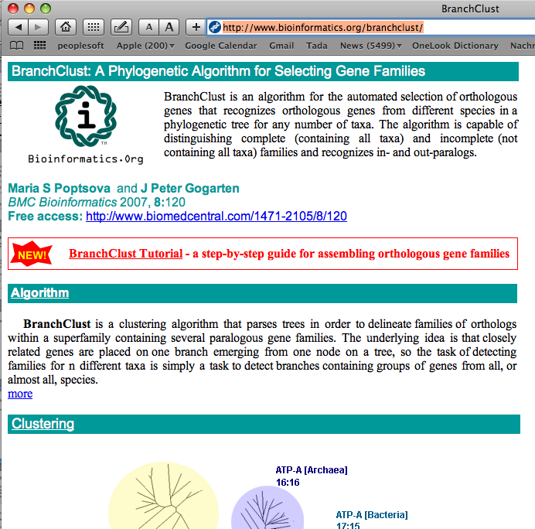
the branchclust scripts
are available at http://www.bioinformatics.org/branchclust/
Consult the tutorial
http://www.bioinformatics.org/branchclust/BranchClustTutorial.pdf

Slide 40
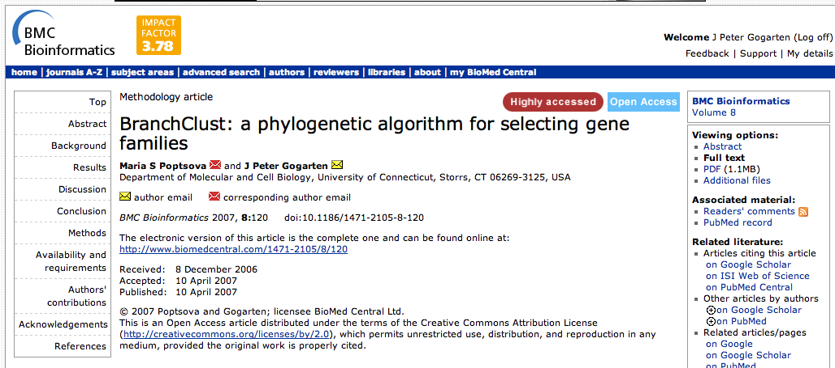
BranchClust Article
is available at
http://www.biomedcentral.com/1471-2105/8/120

Slide 41
Create super families, alignments and trees
perl do_blast.pl
Super Families to Trees
perl parse_superfamilies_singlelink.pl 4
# 4 gives the minimum size of the superfamily
perl prepare_fa.pl parsed/all_vs_all.fam
Creates a multiple fasta file for each superfamily
perl do_clustalw_aln.pl
aligns sequences using clustalw
perl do_clustalw_dist_kimura.pl
calculates trees using Kimura distances for all families in fa
#trees stored in trees
perl prepare_trees.pl
reformats trees

Slide 42
Branchclust
perl branchclust_all.pl 4
# Parameter 4 (MANY) says that a family needs to have
# at least 5 members.
perl make_fam_list.pl 15 10
# results in file called families.list
15 gives the number of genomes, 10 the minimum size of the gene family

Slide 43
Process Branchclust output
perl names_for_cluster_all.pl
# (Parses clusters and attaches names.
# Results in sub directory clusters. List in test)
perl summary.pl
# (makes list of number of complete and incomplete families
# file is stored in test)
perl detailed_summary_dashes.pl
# (result in test: detailed_summary.out - can be used in Excel)
perl prepare_bcfam.pl families.list
#(writes multiple fasta files into bcfam subdirectory.
# Can be used for alignment and phylogenetic reconstruction)

Slide 44
Summary Output
done with many = 3 and
E-value cut-off of 10⁻²⁵
complete: 1564
incomplete: 248
total: 1812
------ details -------
incomplete 4: 87
incomplete 3: 53
incomplete 2: 66
incomplete 1: 42

Slide 45
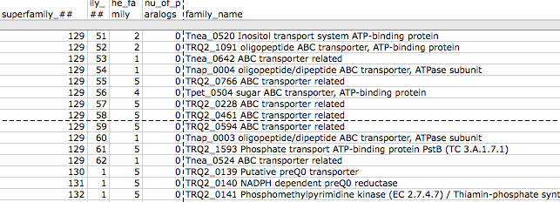
Detailed Summary in Excel
copy detailed summary out onto your computer
In EXEL Menu: Data -> get external data -> import text file ->
in English version use defaults for other options.
In EXEL Menu: Data -> sort -> sort by “superfamily number”-> if asked, check expand selection
Scrolling down the list, search for a superfamily that was broken down into many families.
Do the families that were part of a superfamily have similar annotation lines?
How many of the families were complete?
Do any have inparalogs? Take note of a few super families.

Slide 46
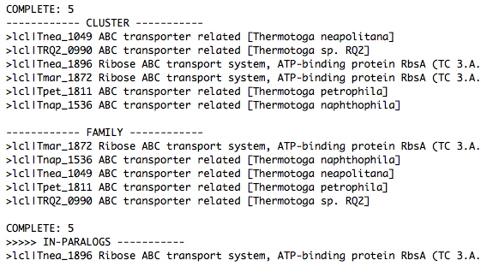
clusters/clusters_NNN.out.names
Check a superfamily of your choice.
Within a family, are all the annotation lines uniform?
Within this report, if there are inparalogs, one is listed as a family member, the other one as inparalog. This is an arbitrary choice, both inparalogs from the same genome should be considered as being part of of the family.
Out of cluster paralogs are paralogs that did not make it into a cluster with “many” genomes.

Slide 47
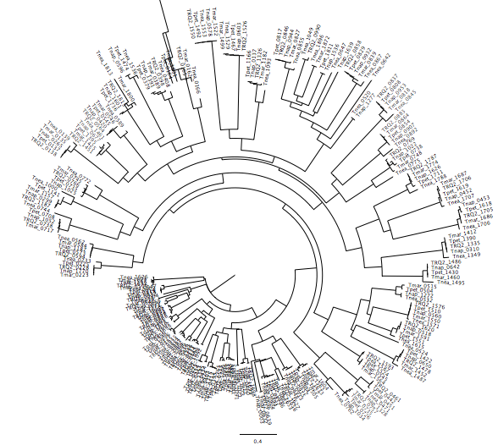
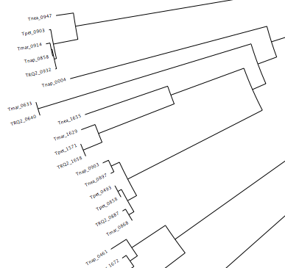
trees/fam_XYZ.tre

Slide 48
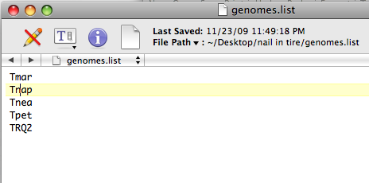
The Quartet Decomposition Server
http://csbl1.bmb.uga.edu/QD/phytree.php
Input A):
a file listing the names of genomes: E.g.:

Slide 49
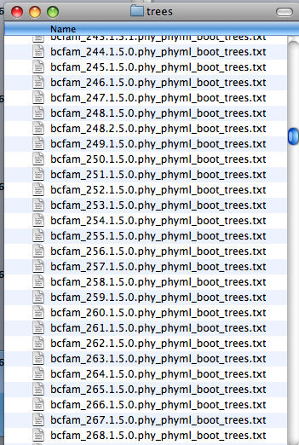
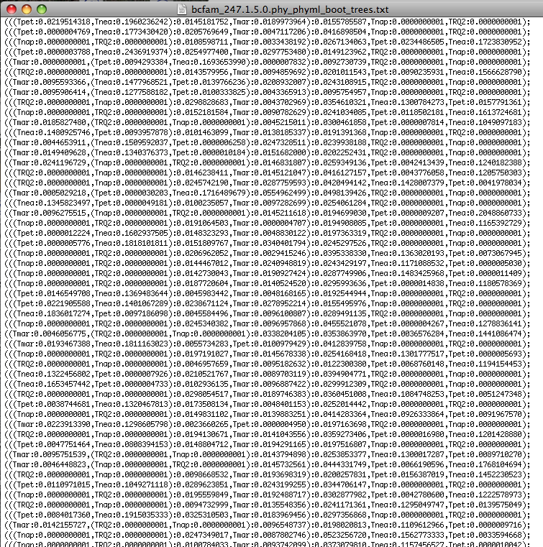
The Quartet Decomposition Server
http://csbl1.bmb.uga.edu/QD/phytree.php
Input B):
An Archive of files where every file contains all the trees that resulted from a bootstrap analysis of one gene family:
One file per family
100 trees per file

Slide 50
The Quartet Decomposition Server
http://csbl1.bmb.uga.edu/QD/phytree.php
Trees from the bootstrap samples should contain branch lengths, but the name for each sequence should be translated to the genome name, using the names in the genome list.
See the following three trees in Newick notation for an example:
(((Tnea:0.1559823230,Tpet:0.0072068797):0.0287486818,Tmar:0.0046676053):0.0407339037,Tnap:0.0000000001,TRQ2:0.0000000001);
(((Tpet:0.0219514318,Tnea:0.1960236242):0.0145181752,Tmar:0.0189973964):0.0155785587,Tnap:0.0000000001,TRQ2:0.0000000001);
(((Tpet:0.0000004769,Tnea:0.1773430420):0.0205769649,Tmar:0.0047117206):0.0416898504,Tnap:0.0000000001,TRQ2:0.0000000001);

Slide 51
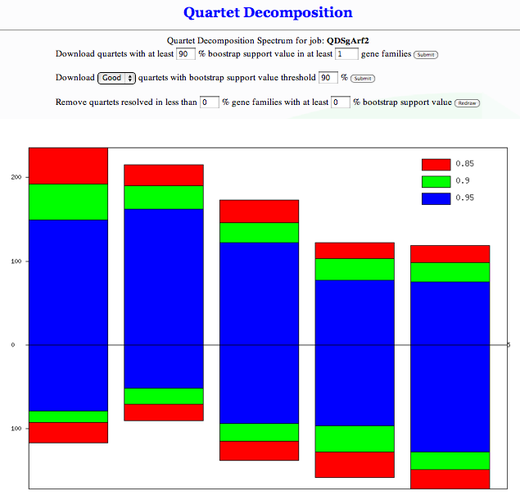
The spectrum http://csbl1.bmb.uga.edu/QD/jobstatus.php?jobid=QDSgArf2&source=0&resolve=0&support=0

Slide 52
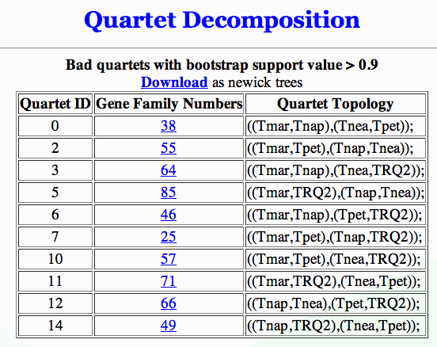
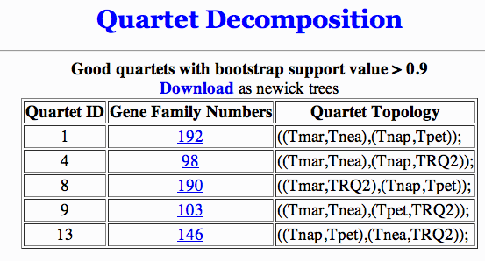
good and bad quartets

Slide 53

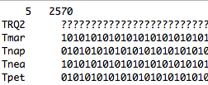

Quartets -> Matrix Representation Using Parsimony
Tmar
Tnea
Tpet
Tnap
…

Slide 54
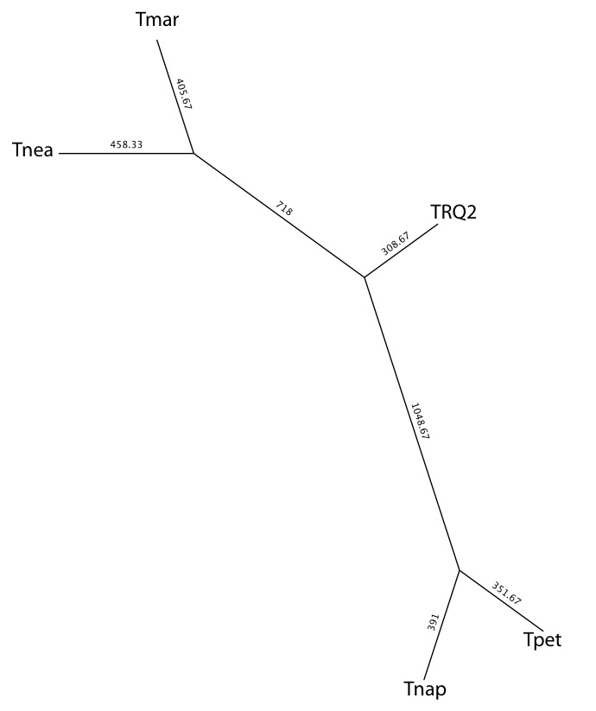
Most Parsimonious Tree (MRP)
Using all Quartets from all Gene Families that have more than 90% bootstrap support

Slide 55
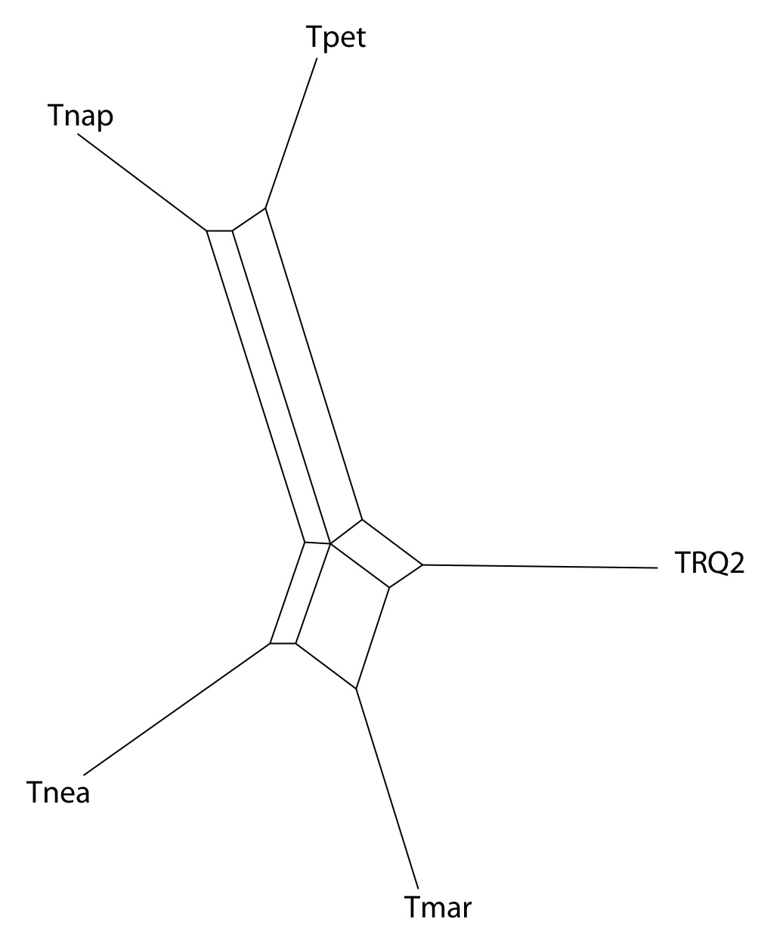
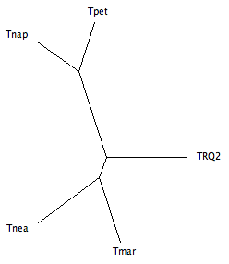
Splits Tree Representation
Using all Quartets from all Gene Families that have more than 90% bootstrap support
Split Decomposition tree
from uncorrected P distances
NJ tree
from uncorrected P distances

